Slide 1
Plants and nutrients
March 5, 2019
Figures from textbooks unless otherwise noted

Slide 2
What essential elements do plants use?

Slide 3
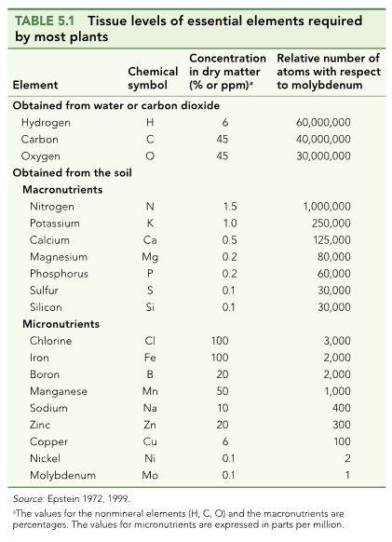

Slide 4
What do they use them for?

Slide 5
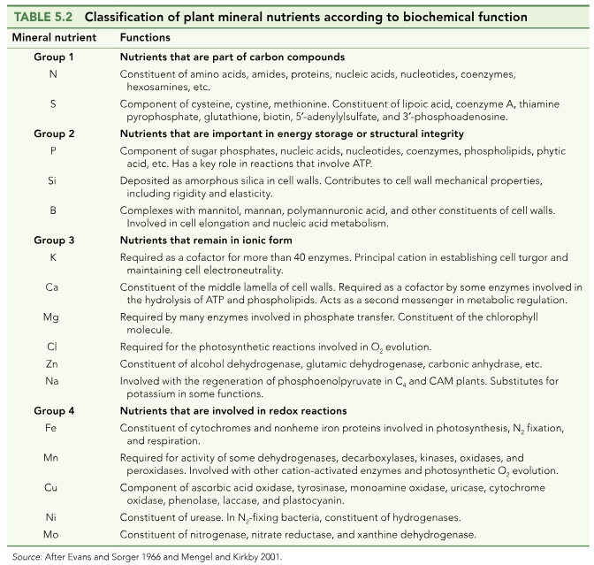

Slide 6
How do nutrients get into the soil?

Slide 7
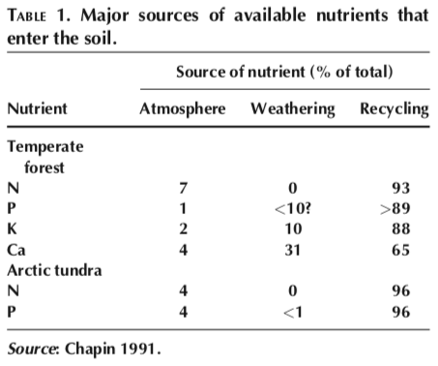

Slide 10
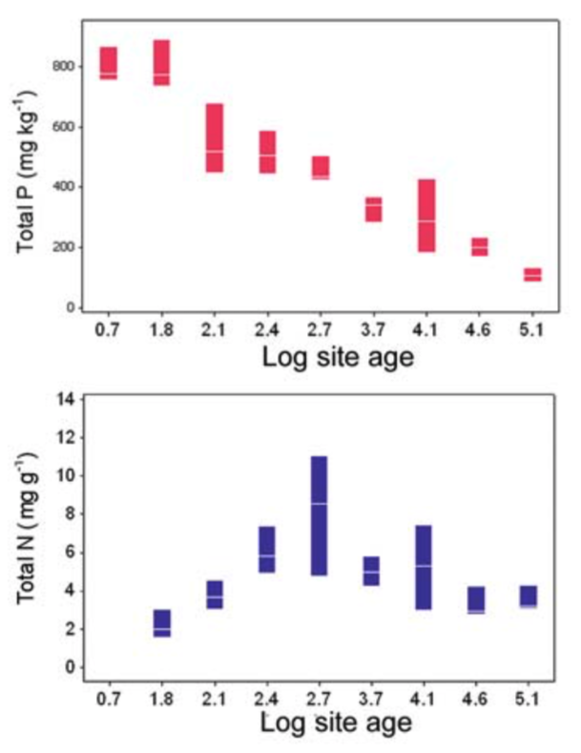
What could explain these trends?

Slide 11
Nutrition impacts: NPP

Slide 12
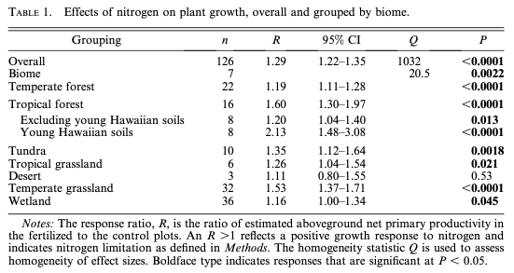
N addition increases NPP by 29% (Lebauer and Treseder, 2008)

Slide 13
N addition increases NPP by 29% (Lebauer and Treseder, 2008)
What could explain this effect?

Slide 14
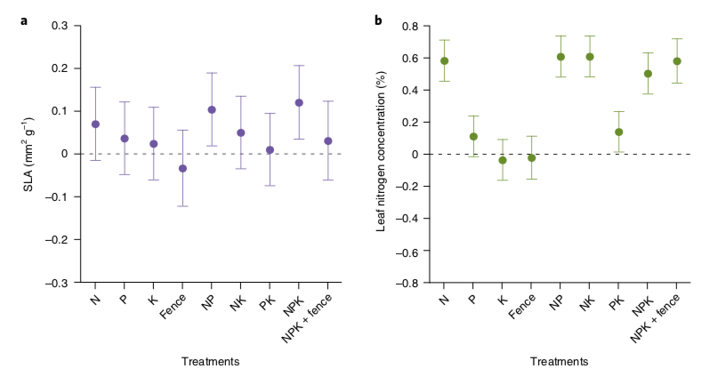
Leaves are basically the same shape, but get packed with more N
Firn et al. (2019)

Slide 15
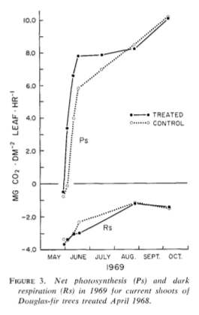
Not necessarily doing more photosynthesis though…
Brix (1971)

Slide 16
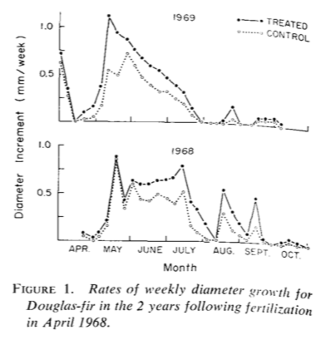
But they are growing!
Brix (1971)

Slide 17
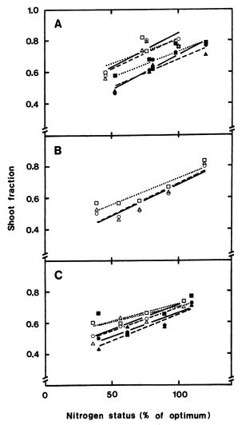
More leaves and shoots are produced at the expense of roots
Ingested et al. (1991)

Slide 18
Nutrition effects on physiological processes
Growth: increases
Storage: increases
Photosynthesis: not necessarily impacted
Allocation: shift to aboveground

Slide 19
Nutrition impacts: Diversity

Slide 20
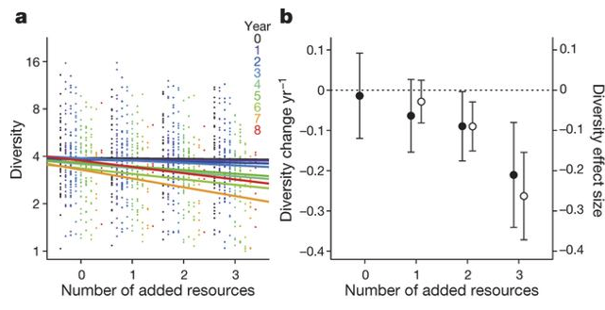
Why would adding nutrients reduce diversity?
Harpole et al. (2016)

Slide 21
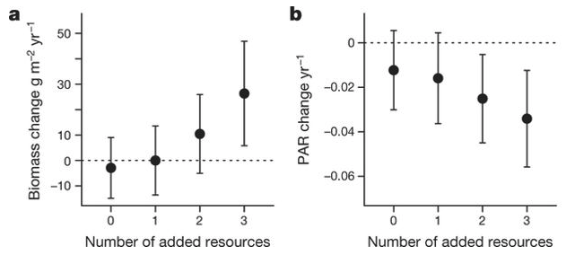
A shift in the importance of other resources!
Harpole et al. (2016)

Slide 22
Competition example: tallgrass prairie

Slide 23
Competition example: tallgrass prairie
Wildflowers
C3
Fast growing
Use a lot of resources (e.g., Nitrogen)
Grasses
C4
Slow growing
Efficient resource use

Slide 24
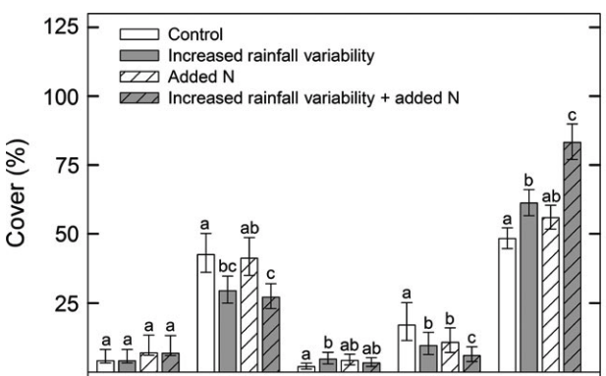
Competition example: tallgrass prairie
Grasses
Wildflowers
Smith et al. (2016)

Slide 25
Competition example: tallgrass prairie
Smith et al. (2016)

Slide 26
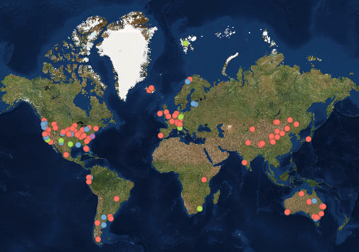
The Nutrient Network: idea for your deliverable?
>100 places all doing the same experiment!
Treatments:
N, P, and K additions
All combinations
With and without herbivores
Measurements
Biomass
Community composition
Light availability

Slide 27
The Nutrient Network: idea for your deliverable?
We have a site in Lubbock!
Contact Nick if you are interested in using the NutNet data (for our site or others)

